Slide 1
2023 Strategic Plan
SCTE Rocky Mountain Chapter
Q2.2023

Slide 2
Our Vision
SCTE Rocky Mountain
Be the best chapter in the world

Slide 3
Our Mission
SCTE Rocky Mountain Chapter
Be the best chapter in the world by enriching the lives of our members through ongoing growth, development and connectivity

Slide 4
About Us
SCTE Rocky Mountain Chapter is located in the heart of “Denver Cable.” Denver is the pioneering home to 17+ cable headquarters, back in the day, pre-consolidation.
We serve members from northern New Mexico to the Rocky Mountains in Colorado and into Wyoming. Because of this, we are an especially beautiful chapter to visit and join!
We take great pride in serving telecommunication professionals in the Rocky Mountain region. Our programs range from chapter meetings to webinars, training seminars and vendor events. Our annual Engineering Symposium and Golf in the summer is not to be missed. All of these opportunities provide ample networking opportunities within a technologically vibrant community.

Slide 5
Our Strategic Objectives
Strategic Goal Framework
Grow the chapter expanding the reach of the chapter service to as many members as able while also serving the greater industry and community.
Connect with like-minded organizations to further promote resources available to the local members, industry and community at large.
Grow
Connect
Challenge status quo to evolve and progress the chapters approach to serving its members (e.g., new website, introduction of virtual learning and more).
Operate with Excellence
Optimize operations to ensure fundamentals of operating the chapter are executed with excellence enabling growth, transformation and connectivity.
Transform

Slide 6
Our Strategic Goals
How the Committees and Efforts Align
Grow
Membership
Sponsorships / Fund Raising
Strategy
Connect
Community Outreach and Enrichment
Symposium / Cable Games / Golf
SWAG
Transform
Technology
Marketing and Communications
Professional Development
Social Media
Operate with Excellence
Financial Review / Audit
Chapter Compliance / Reporting
Executive Committee / Nominations

Slide 7
Grow
Grow
Enable
Evolve
Membership / Recruiting / Outreach
Strategy
Sponsorships / Fundraising
Scott Noar
Sally Huriaux, John Williams, David Harrison. Gretchen Wanzeck, Kelly Rapoza
Sally Huriaux
Rachel Solomon, Rich Rutledge, Abbie O’Dell
Niem Dang
Brandee Brown, David Harrison John Williams Travis Taylor
Set new goal for 2023, Ended the year at 718, Starting the year at 344 members, up to 710 by 3/15
Increase sponsorship at the leadership level
Evaluate in person events and recruiting; i.e. tables at employee locations
Recruiting materials; ensure people know if this is for them – do they fit being a member if not a traditional technologist
Create collateral to communicate with prior members and potential new members
Collaborating across multiple events and outlining proposed budgets for events
Comcast CONNECT Org contributed 5K March
Complete 2023 review of plan
Propose to group sub committee readouts in alignment with strategic objectives
Evaluate any new subcommittees needed, or any that may no longer make sense to maintain
Complete 2022 Strategic Evaluation
Evaluate cadence for 2023 to not duplicate monthly notes/ more strategic review
Grow the chapter expanding the reach of the chapter service to as many members as able while also serving the greater industry and community.

Slide 8
Transform
Connect
Evolve
Deeper Reach
Enrich
Social Media
and Technology
Professional Development
Marketing and Communications
Justin Stiles, Andy Frederick
Ron Hranac, Bob DeBaggis, Travis Taylor,, Scatt Noar
Bob DeBaggis
Ron Hranac, Diana Linton, Travis Taylor
Kimberly Alexis, Andrew Gough Chris Miranda, Jeanne Crawford, Nick Segura
Challenge status quo to evolve and progress the chapters approach to serving its members (e.g., new website, introduction of virtual learning, etc.).
Combine Social Media and Technology in 2023
Posts on Instagram FB, LinkedIn, Twitter and Chapter website for updates and member interaction underway including posting about last Thursday events etc.
Merge Social Media and Technology together
Evaluating fb live events to bring in key industry leaders to connect live with members
Monitor 2023 volume and plan
Look to potentially merge with marketing / comms
2023 goal to empower sub-committees
Lag to recordings to push in person attendance
Constant contact email
Outline 2023 plan
Monthly newsletter publications
Monthly reminders for last Thursday events and boot camps
Ongoing member of the month inclusion
White papers woven into monthly newsletters
Create 2023 schedule
Envelop into the cadence career journey conversations, connecting with certifications as applicable
Continuation of monthly cadence
Focus on video files and speaker release forms
Explore quarterly in person

Slide 9
Connect
Expand
Enrich
Attract
Community
Outreach & Enrichment
Symposium, Cable Games, Golf
SWAG
Diana Linton
Brandee Brown, Kimberly Alexis, Jeanne Crawford, Stacey Slaughter
Gretchen Wanzeck
Stacey Slaughter, Jeanne Crawford, David Harrison, John Williams, Niem Dang, Andy Frederick. Scott Noar, Brandee Brown, Brian Kenny, Justin Stiles, Kevin Kwasny
Jennifer Tyrel
Jason Rupe, Rich Rutledge, Rachel Solomon
Connect with like minded organizations to further promote resources available to the local members, industry and community at large.
Outline 2023 plan
Industry kick off
Evaluating additional industry partner events
Highschool connectivity
Explore school outreach program and vendor days as these were deficits in 2022
Community Outreach event 3/11
Start planning in Q1; make sure leadership sponsorship to enable employees to attend
The Ridge is available 6/21 and could do cable games the night prior conflict with Charter All Hands so may need to deconflict
Voted in 1/18 session to order initial swag (shirts) for board and assistant board members to help with awareness and recruiting of new members at events,

Slide 10
Operate with Excellence
Operate
Add
Bench Strength
Financial Review / Audit
Executive
Compliance / Reporting
Chris Miranda, Rich Rutledge
David Harrison, Stacey Slaughter, Kevin Kwasny
Kim Stand, Paul Schauer
Brandee Brown, Rich Rutledge
Abbie O’Dell
Scott Noar, Brandee Brown, Rich Rutledge
Complete annual financial review of income and expenses for 2022
Send the top 10 Financials & Chapter Treasures Handbook sent to this team and CFO
Complete quarterly financials
Set goal for 2023 and any updates to the plan
Kicked off year strong with new matrix of points by subcommittee to help teams understand the role they play there
Establish strong bench for future board members through highly engaged and experienced board and assistant board members
Produce Succession Planning to Natl
Ensure all board members inc. Assoc. signed COI & NDA
Potential to pick up SCTE EXPO Planning
Conduct election in Q4 2023
Optimize operations to ensure fundamentals of operating the chapter are executed with excellence enabling growth, transformation and connectivity.
Election
Kim Strand
Kevin Kwasny

Slide 11
2023 Board Members
Abbie O’Dell
Scott Noar
Brandee Brown
Rich Rutledge
Sally Huriaux
Chris Miranda
President
Vice President
Secretary
Treasurer
Strategic Planning
Kelley Rapoza
Andy Frederick
Kevin Kwasny
Diana Linton
Justin Stiles
Gretchen Wanzeck

Slide 12
2023 Assistant Board Members
Ron Hranac
Rachel Solomon
Larry Wolcott
Nick Segura
Stacey Slaughter
Bob DeBaggis
Dajuan Mayo
Jill Bharwani
Brian Kenny
Paul Schauer
John Williams
Kim Strand
Travis Taylor
Jennifer Tyrrel
Andrew Gough
Jeanne Crawford
Kimberly Alexis
Randy Westrick
David Harrison
Niem Dang
Jason Rupe

Slide 13
2023
Q1
Q1 Highlights
Abbie O’Dell voted in as President, Scott Noar vote in as Vice President, Rich Rutledge voted in as Treasurer
Creating greater clarity in 2023 on compliance and points allocation and ownership for better visibility and execution
Completed 2022 Evaluation
Quarterly Highlights Against Strategic Objectives
Q2
Q2 Highlights
June 20 - Symposium, Cable-Tec Games, Member Appreciation
June 21 - Golf
Q3
Q3 Highlights
Oct 16-19 EXPO in Denver
Q4
Q4 Highlights
Add

Slide 14
Succession Planning
Succession Planning for Board / Officer positions
President elect currently filled by Abbie O’Dell
Successor(s): Scott Noar
Vice President elect currently filled by Scott Noar
Successor(s): Rich Rutledge
Secretary elect currently filled by Brandee Brown
Successor(s): Jill Bharwani
Treasurer elect currently filled by Rich Rutledge
Successor(s): Chris Miranda
VP, Membership currently filled by Gretchen Wanzeck
Successor(s): Diana Linton
VP, Professional Development Currently filled by Kelley Rapoza
Successor(s): Kimberly Alexis
VP, Marketing and Communications currently filled by Bob DeBaggis
Successor(s): Travis Taylor
VP, Technology, CTO currently filled by Justin Stiles
Successor(s): Andrew Frederick
VP, Strategy currently filled by Sally Huriaux
Successor(s): Scott Noar, Jason Rupe
Successors Open for any Role: Larry Wolcott, Jason Rupe
Each officer term is allowed one re-election for a maximum term limit of two years for President and VP; and four years for Treasurer and VP. Eligible for other officer roles for up to five consecutive years and then must sit out for one thereafter
Current list of roles and interested parties

Slide 15
2023 Schedule of Events
2023 RMC Board of Directors Meetings 3:00 – 5:00 pm MT | 2023 Last Thursday Seminar Events 4:00 – 5:30 pm MT | Chapter Leader to Open Session | Other Events
18-Jan | N/A | N/A | 18 Jan: Strategic Planning 2-3 pm MT)
15-Feb | 23-Feb | Ron Hranac | Industry Kick Off Feb 23
15-Mar | 30-Mar | Gretchen Wanzeck | Light Reading Event Mar 14-15 Chapter Leader Conference Mar 29-30
19-Apr | 27-Apr | Travis Taylor
17-May | 25-May | Brandee Brown
21-Jun | 29-Jun | Andy Fredrick | June 20 - Symposium, Cable-Tec Games, Member Appreciation June 21 - Golf
19-Jul | 27-Jul | Randy Westrick
16-Aug | 31-Aug | Abbie O’Dell
20-Sep | 28-Sep | David Harrison
18-Oct | 26-Oct | Diana Linton | Oct 16-19 Expo
15-Nov | 30-Nov | Travis Taylor
20-Dec | 14-Dec | Kevin Kwasny | Dec-6 Vendor Showcase/Member Appreciation

Slide 16
2023 Schedule of Calendar Events – Details
Date | Location | Time | Event Type | Topic Category | Subject | Speaker | Company | Meeting Administrator | Board Organizer (s)
2/23/23 | Live | 5:00 PM - 8:00 PM | Technical Training & Industry Kickoff | Fundamentals | Cable 101 | Ron Hranac | Independent
3/11/23 | Live | 10:00 AM - 12:00 PM | Outreach |  | High School Student event at Cable Center
3/14 - 3/15/23 | Live | 8:00 AM - 5:00 PM Daily | Booth & Industry Event Partnership |  | Cable Next Gen Light Reading
3/30/23 | Virtual | 4:00 PM - 5:30 PM | Technical Training | Current/EmergingTechnology | OUDP Leakage | Eric Olsen | Viavi | Gretchen Wanzeck
4/13/23 | Live | 8:00 AM - 6:00 PM | Outreach / Partnership |  | CSU STEM Program Judging - Ft. Collins |  |  |  | Justin Stiles, Diana Linton
5/4/23 | Hybrid | 4:00 PM - 5:30 PM | Technical Training | Future Technology | NextGen Open Shift Platform | Tim Jones | RedHat | Travis Taylor
5/25/23 | Virtual | 4:00 PM - 5:30 PM | Technical Training | Current/EmergingTechnology | DAA | TBD |  | Brandee Brown
6/20/23 | Live | 4:00 PM - 8:00 PM | Cable Games, Member Appreciation
6/21/23 | Live | 7:00 AM - 2:00 PM | Vendor Showcase & Golf Tournament
6/22/23 | Hybrid | 3:00 PM - 5:30 PM | Technical Training | Future Technology | DOCSIS 4.0 | TBD | CableLabs | Randy Westrick
7/27/23 | Virtual | 4:00 PM - 5:30 PM | Technical Training | Field Technical Operations | Ingress Testing in Plant vs. Egress Testing | Flavio Marcon | Effigis | TBD
8/31/23 | Hybrid | 4:00 PM - 5:30 PM | Technical Training | Fundamentals | High Fiber - The Fundamentals | Kendall Robinson | NCTI | Abbie O'Dell
9/28/23 | Virtual | 4:00 PM - 5:30 PM | Technical Training | Current/EmergingTechnology | Cable Gymnastics - Doing the High Split | TBD |  | David Harrison
10/16/23 | Live | 5:00 PM - 6:30 PM | Chapter Teamwork - Board Officer Training |  | Rocky Mountain Hosted event at Expo
10/26/23 | Virtual | 4:00 PM - 5:30 PM | Technical Training | Fundamentals | Putting the Fun in Fundamentals - RF Basics | Ron Hranac | Independent | Diana Linton
11/30/23 | Virtual | 4:00 PM - 5:30 PM | Technical Training | Future Technology | Lucky Number Seven - WiFi 7.0 | James Scherz | NCTI | Travis Taylor
12/6/23 | Live | 4:00 PM - 7:30 PM | Vendor Showcase & Member Appreciation
12/14/23 | Virtual | 4:00 PM - 5:30 PM | Technical Training | Future Technology | Topic TBD

Slide 17
APPENDIX

Slide 18
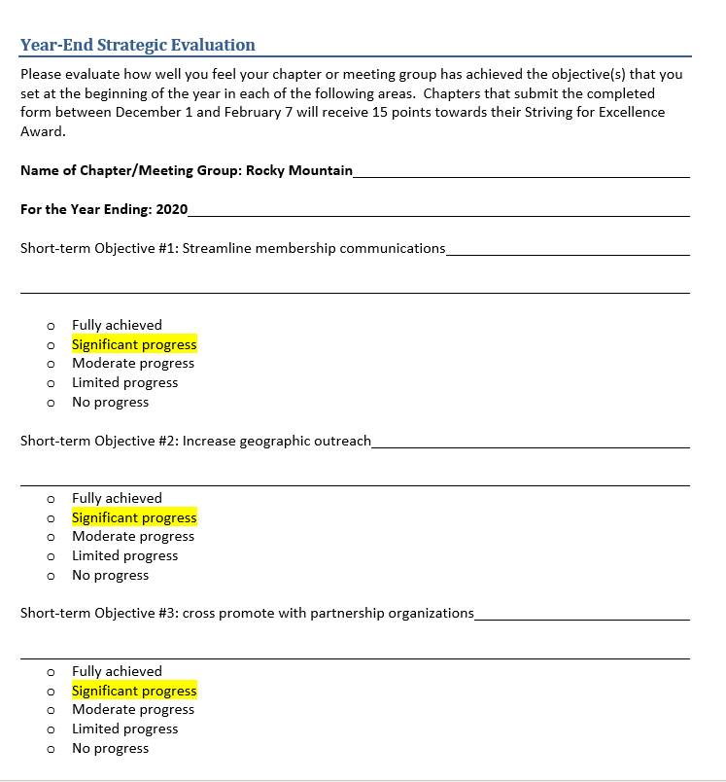
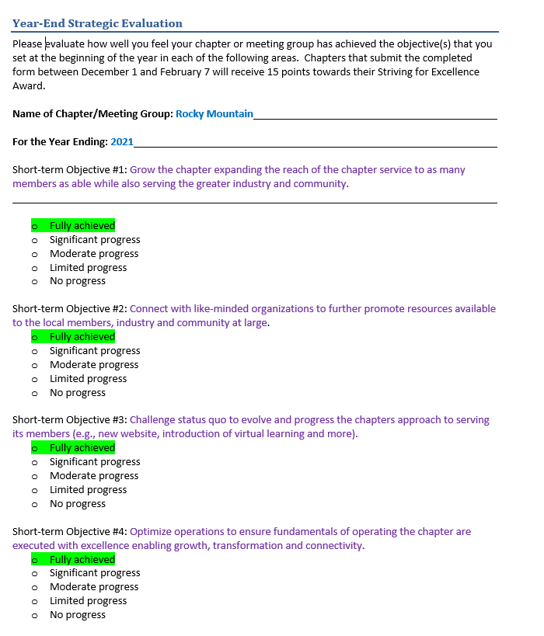
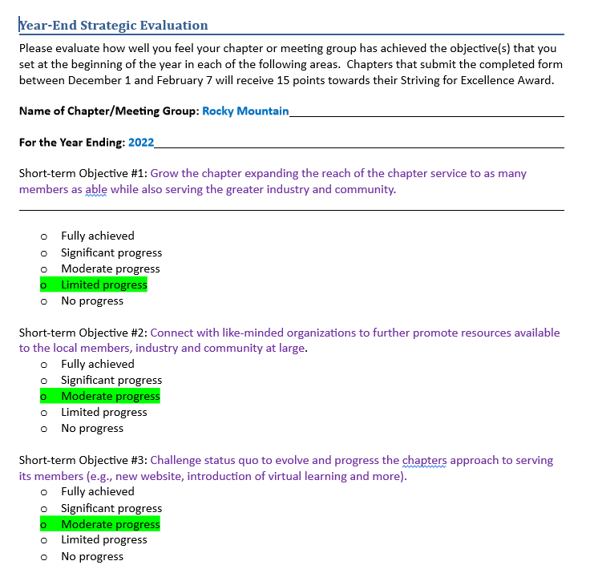
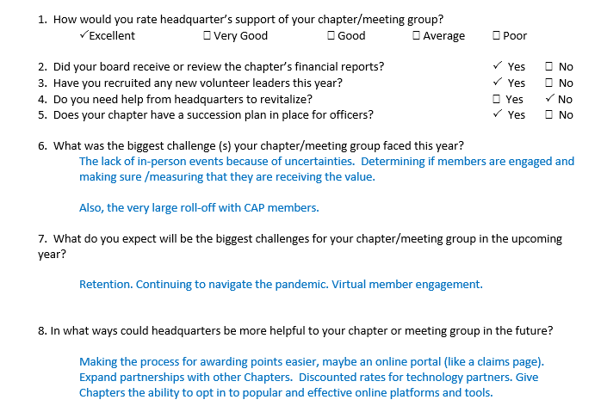
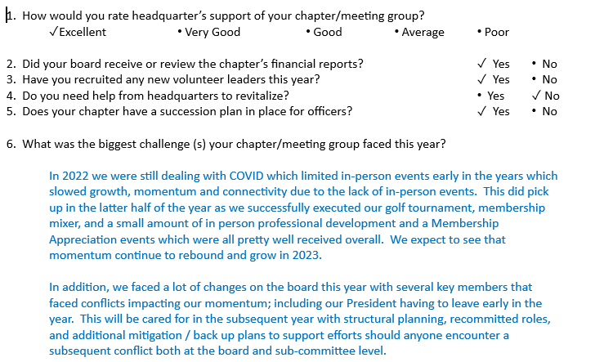
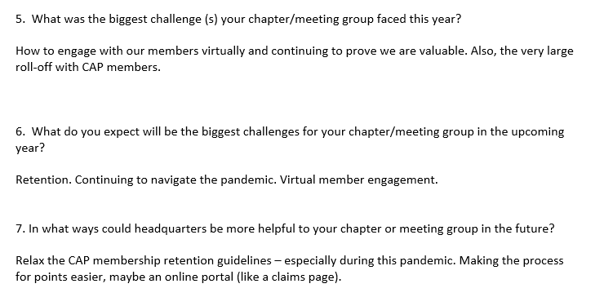
History
2020 Strategic Evaluation
2021 Strategic Evaluation
2022 Strategic Evaluation
Last three years strategic highlights

Slide 19
Resources
Chapter Website
Calendar / Events
Newsletter
Training
Certifications
Chapter Facebook Page
Chapter Twitter Page
Chapter LinkedIn Page
Chapter Document Storage
Financial Statements
Meeting Minutes
Pictures
Etc.
National Website

Slide 20
2023 Committee Lists
Committee: Technology
Role: Oversight in all technology from website to online communications; webinar admin for events Web site design / Email list management / File - document archive management / Webinars
Strategic Goal: Transform
Time Needed: 3-8 hours per month, 12 months per year more near symposium
Committee: MARCOM / Marketing and Communications
Role: Collection of content for timely communication and publication of events, info, monthly newsletter. Oversight of all communications, email campaigns, photography and videography at events. SCTE literature, events and table
Strategic Goal: Transform
Time Needed: 4 hours per month, 12 months per year
Committee: Professional Lead: Abbie O’Dell( Charter), Chris Miranda (Comcast)
Members: Nick Segura
Role: Focus on certification, test prep and test taking. Coordinate/establish monthly trainings, publication efforts to advertise of training events
Strategic Goal: Transform
Time Needed: 2-3 hours per month, 12 months per year
Committee: Social Media *NEW*
Role: Support trainings, membership drives, sponsorships, symposium/cable games/golf, etc by posting information onto our social media sites, including Facebook, Twitter, LinkedIn, etc.
Strategic Goal: Connect
Time Needed: 1-2 hours per month, 12 months per year
Committee: Membership / Recognition - Retention
Role: Increasing and maintaining our membership, recognizing outstanding participation. Retention and recruiting email campaign and monthly attendance reporting
Strategic Goal: Growth
Time Needed: 4 hours per month, 12 months per year
Committee: Sponsorships / Fundraising
Role: All efforts to support chapter: sponsorships, etc.
Strategic Goal: Growth
Time Needed: 2-3 hours per month, 12 months per year more near symposium
Committee: Strategy
Role: Creation and management of strategic plan; ensuring performance of plan aligns with strategic goals
Strategic Goal: Growth
Time Needed: 2-4 hours per month, 12 months per year

Slide 21
2023 Committee Lists
Committee: Financial Review / Audit
Filled by: One board member and two assistant board members per bylaws
Role: Conduct annual review of Chapter finances for previous FY, assist treasurer as necessary (Due end of 3/31 for points)
Strategic Goal: Operate with Excellence
Time Needed: 2-3 hours per year
Committee: Chapter Compliance/Reporting
Role: Attending to our Chapter points matrix and compliance reporting
Strategic Goal: Operate with Excellence
Time Needed: 4-6 hours per month, 12 months per year
Committee: Executive Committee
Filled by: President, VP, Secretary and Treasurer per bylaws
Role: Board orientation, grooming, succession, Associate assignments
Strategic Goal: Operate with excellence
Time Needed: 2-3 hours per month, 12 months per year
Committee: Nomination (Formerly Election Committee)
Filled by: Secretary per by laws
Role: End of 4Q2021: Organize, recruit, facilitate 2021 election
Strategic Goal: Operate with Excellence
Time Needed 2-3 hours per month, 2-3 months per year
Committee: Community Outreach
Role: Planning, executing outreach programs for schools, robotics, other industry participation
Strategic Goal: Connect
Time Needed: 1-2 hours per year, 12 months per year –intermittent
Committee: Symposium / Cable Games / Golf
Role: Plan and organize annual golf tournament, cable games, symposium and vendor day Strategic Goal: Connect
Time Needed: 20-30 hours per month, 6 months per year
Committee: SWAG (Promo Selection)
Role: Define need, budget for promo items
Strategic Goal: Connect
Time Needed: 2 hours per month, 2-3 months per year

Slide 22
2023 Role Duties
President - The Presiding Officer
Chairs the Executive committee and regular board meetings
Arranges a minimum of four chapter board meetings per year. To conduct business, the meeting must have quorum, at least 50 percent of board members in attendance.
Ensures the board performs its duties in keeping with the bylaws and policies.
Leads the chapter by participating in the development of strategic goals and by working with the chapter board and membership to achieve those goals.
Ensures all leaders perform the functions for which they are responsible and takes appropriate action if individuals are not performing their duties.
Impartially guides the discussion of business during official meetings of the membership or board.
Serves as a link between SCTE•ISBE as headquarters and the local chapter.
Appoints committees as needed.
Helps to identify and implement services/programs for chapter members.
Keeps current with SCTE•ISBE services and promotes the mission of SCTE•ISBE locally.
Serves as the chapter’s spokesperson.
Recognizes achievements of chapter leaders and members.
President-Elect / Vice President
These responsibilities help to ensure that the president-elect is fully prepared to assume the presidency, rather than attempting to learn about the organization while trying to lead it. In some cases, the president-elect or vice president does not automatically succeed the outgoing president. However, it is still important for this leader to be able to manage the chapter in the absence the president or if the president’s position becomes temporarily vacant.
The president-elect learns how to lead the chapter/meeting group by
Monitoring progress of chapter’s goals and objectives
Enforcing the bylaws
Fulfilling responsibilities assigned by the president
Advising and assisting the president
Assuming President’s role in president’s absence
Learning the details of chapter/meeting group operations

Slide 23
2023 Role Duties
Secretary - The official recorder and record keeper
Prepares and distributes minutes of official board and membership meetings.
Oversees the completion of meeting reports and their filing with headquarters.
Maintains all official documents (e.g., bylaws, minutes, board contacts, elections, etc.) and updates those documents as required (e.g., files amendments to the bylaws with headquarters, etc.).
Work with the Membership chair/vice president to coordinate mailings/emails.
Vice President of Professional Development
Oversees the Events and Certification subcommittees
Enhances & improves educational seminars and chapter meetings and ensures promotion of the events through meeting notices, website, and social media
Investigates “partnering” educational opportunities with other organizations
Develops programs for the year to enhance the cable broadband profession
Works with other chapter officers to promote events
Vice President, Membership
Oversees the Election subcommittee
Identifies potential members
Develops membership and retention campaigns
Maintains chapter mailing lists
Develops surveys to assess needs of chapter members
Treasurer, Vice President of Finance
Oversees the Finance and Fundraising committees
Maintains all financial accounts and records, and proper documentation of all financial transactions.
Provides written and/or oral reports on the organization’s financial status at each board meeting which is to be captured in the minutes.
Prepares quarterly and year-end financial reports, which are filed with headquarters.
Reconciles the chapter’s QuickBooks accounts.
Monitors cash flow.
Prepares annual budget with the help of other officers.
Maintains banking relationship with local bank.
Ensures that the 501(c)(6) disclaimer is on chapter receipts and advertisements.

Slide 24
2023 Role Duties
Vice President of Strategy
Oversees the compliance and recognition subcommittees
Participate on the executive committee to establish the strategic direction of the chapter
Identify projects and programs to support the strategic goals
Track and report on the progress of the execution against those goals
Recommend and form ad-hoc subcommittees pursuant to the execution of those goals
Vice President of Marketing and Communications
Oversees the Community Outreach and Communications subcommittees
Produces & edits e-mail notifications for chapter meetings, hard copy fliers and newsletters
Coordinates stories and production
Recruits members to write articles
Acts as a liaison with other SCTE•ISBE chapters and local cable groups
Manages social media accounts
Vice President of Technology, CTO
Maintains chapter website operations
Prepares and sources new content and updates
Maintain chapter calendar of events
Content capturing for use (website/social media, etc.)
Website updates as requested by the Committee
Generate content for social media / online publications / online chapter presence
Maintain and publish chapter technology assets list
Scheduling, reserving, coordinating, and recording monthly Webinars for publication on SCTE’s website
Maintain central documentation repository for chapter use

Slide 25
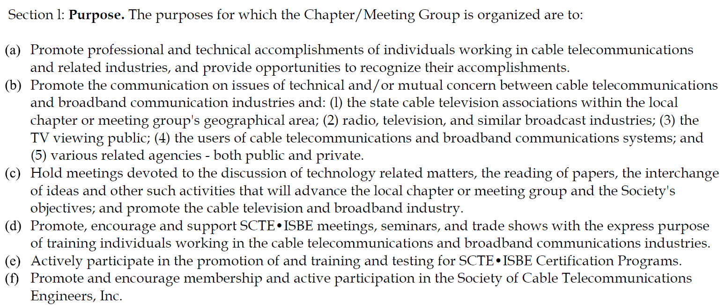
SCTE Bylaws – Purpose of Local Chapter

